Slide 1
Innovation Hack
Team Name: AlphaOmega

Slide 2
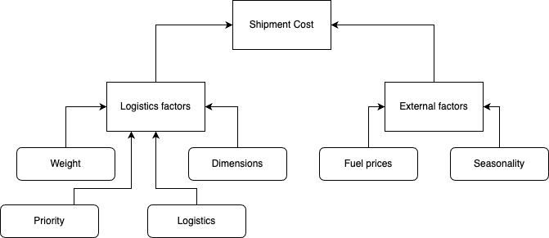
Theme:
Price Prediction Model
Objective:
Building an Artificial Intelligence model which can predict pricing for shipment considering quantitative data variables and indicators using real world datasets.
The cost is determinant on variety of different factors such as:
1. Distance
2. Weight, Volume and Dimensions
3. Nature of goods
4. Delivery timeframe
5. Fuel Prices
6. Seasonality
7. Geographical factors
8. Carrier costs
9. Economic factors etc

Slide 3
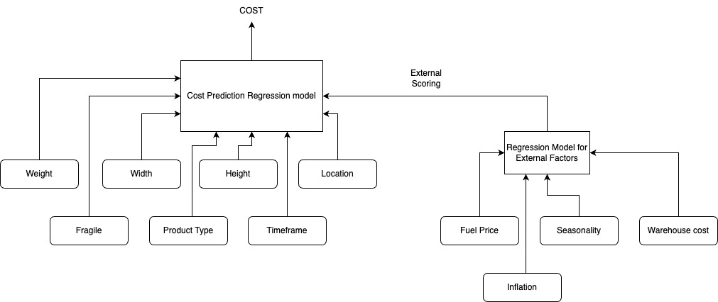
Solution : The proposed solution is an artificial Intelligence model which takes data of logistics shipment and external factors into account to predict cost of shipping for an item. The user will be able to enter data using an interactive page and get cost prediction.
We will use a stacking ensemble regression mode which will be a 2-layer model.
The cost model will cater to important input such as :
Weight
Location
Timeframe
Width and Height
Fragile
Product type
Material
External Indicator Score for Base Shipping price :
This is another model which considers the variables such as fuel price changes, warehouse cost, economic changes etc
The model will be trained on huge dataset using various models such as XGBoost, LightGBM, CarBoost, MLR and DNN etc to find the most accurate stacking configuration

Slide 4
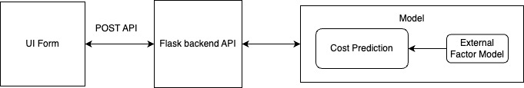
Architecture:
The underlying model will be built in python and trained on data; It will be loaded into the python flask application.
For purposes of demo and prototype, an API endpoint and UI form will be available to provide values to variables such
as weight, location, priority etc. and the model will return with price prediction. Furthermore, it can take some external parameters such as fuel price, inflation etc. to provide more accurate predictions.
The model’s notebook will also be available to train it on different data values.
It will also have a dashboard which will show key metrics for the data
Tech Stack:
Language - Python
Data Analysis, visualisation and manipulation - NumPy, Pandas, Matplotlib, scikit-learn, TensorFlow
Tools and framework - Anaconda Navigator, Jyupter, Git, flask

Slide 5
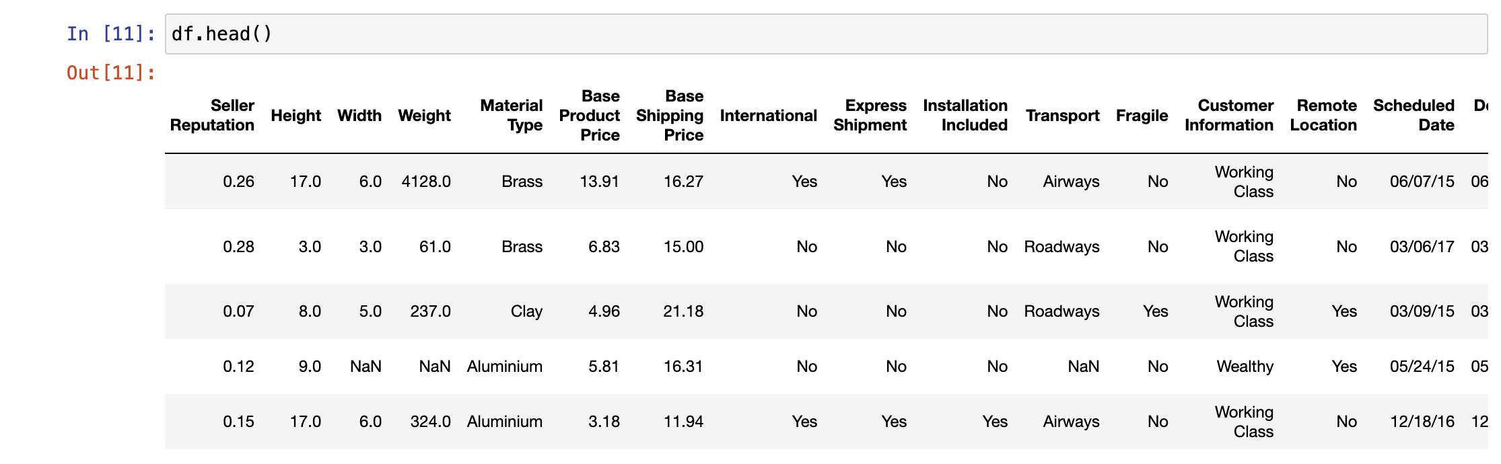
Methodology and analysis:
Using various available datasets and features, the analysis for an intelligent model depicts key variables and metrics.
The dataset have been built using conjunction of different real-world datasets since a dataset is not yet provided, in case of a dataset is provided in prototyping phase, similar analysis procedure would be followed to define important variable, their correlation and impact on cost.
As mentioned, the cost depends on various input, such as weight, height, width, material type, seller, if it is express shipment, if it is fragile etc.
Some of these are shown in the fig. All these points are taken as input for cost prediction model.
The Base Shipping Price will be output from another model which changes based on factors such as fuel pricing, seasonality, economic factors thus it will change accordingly.

Slide 6
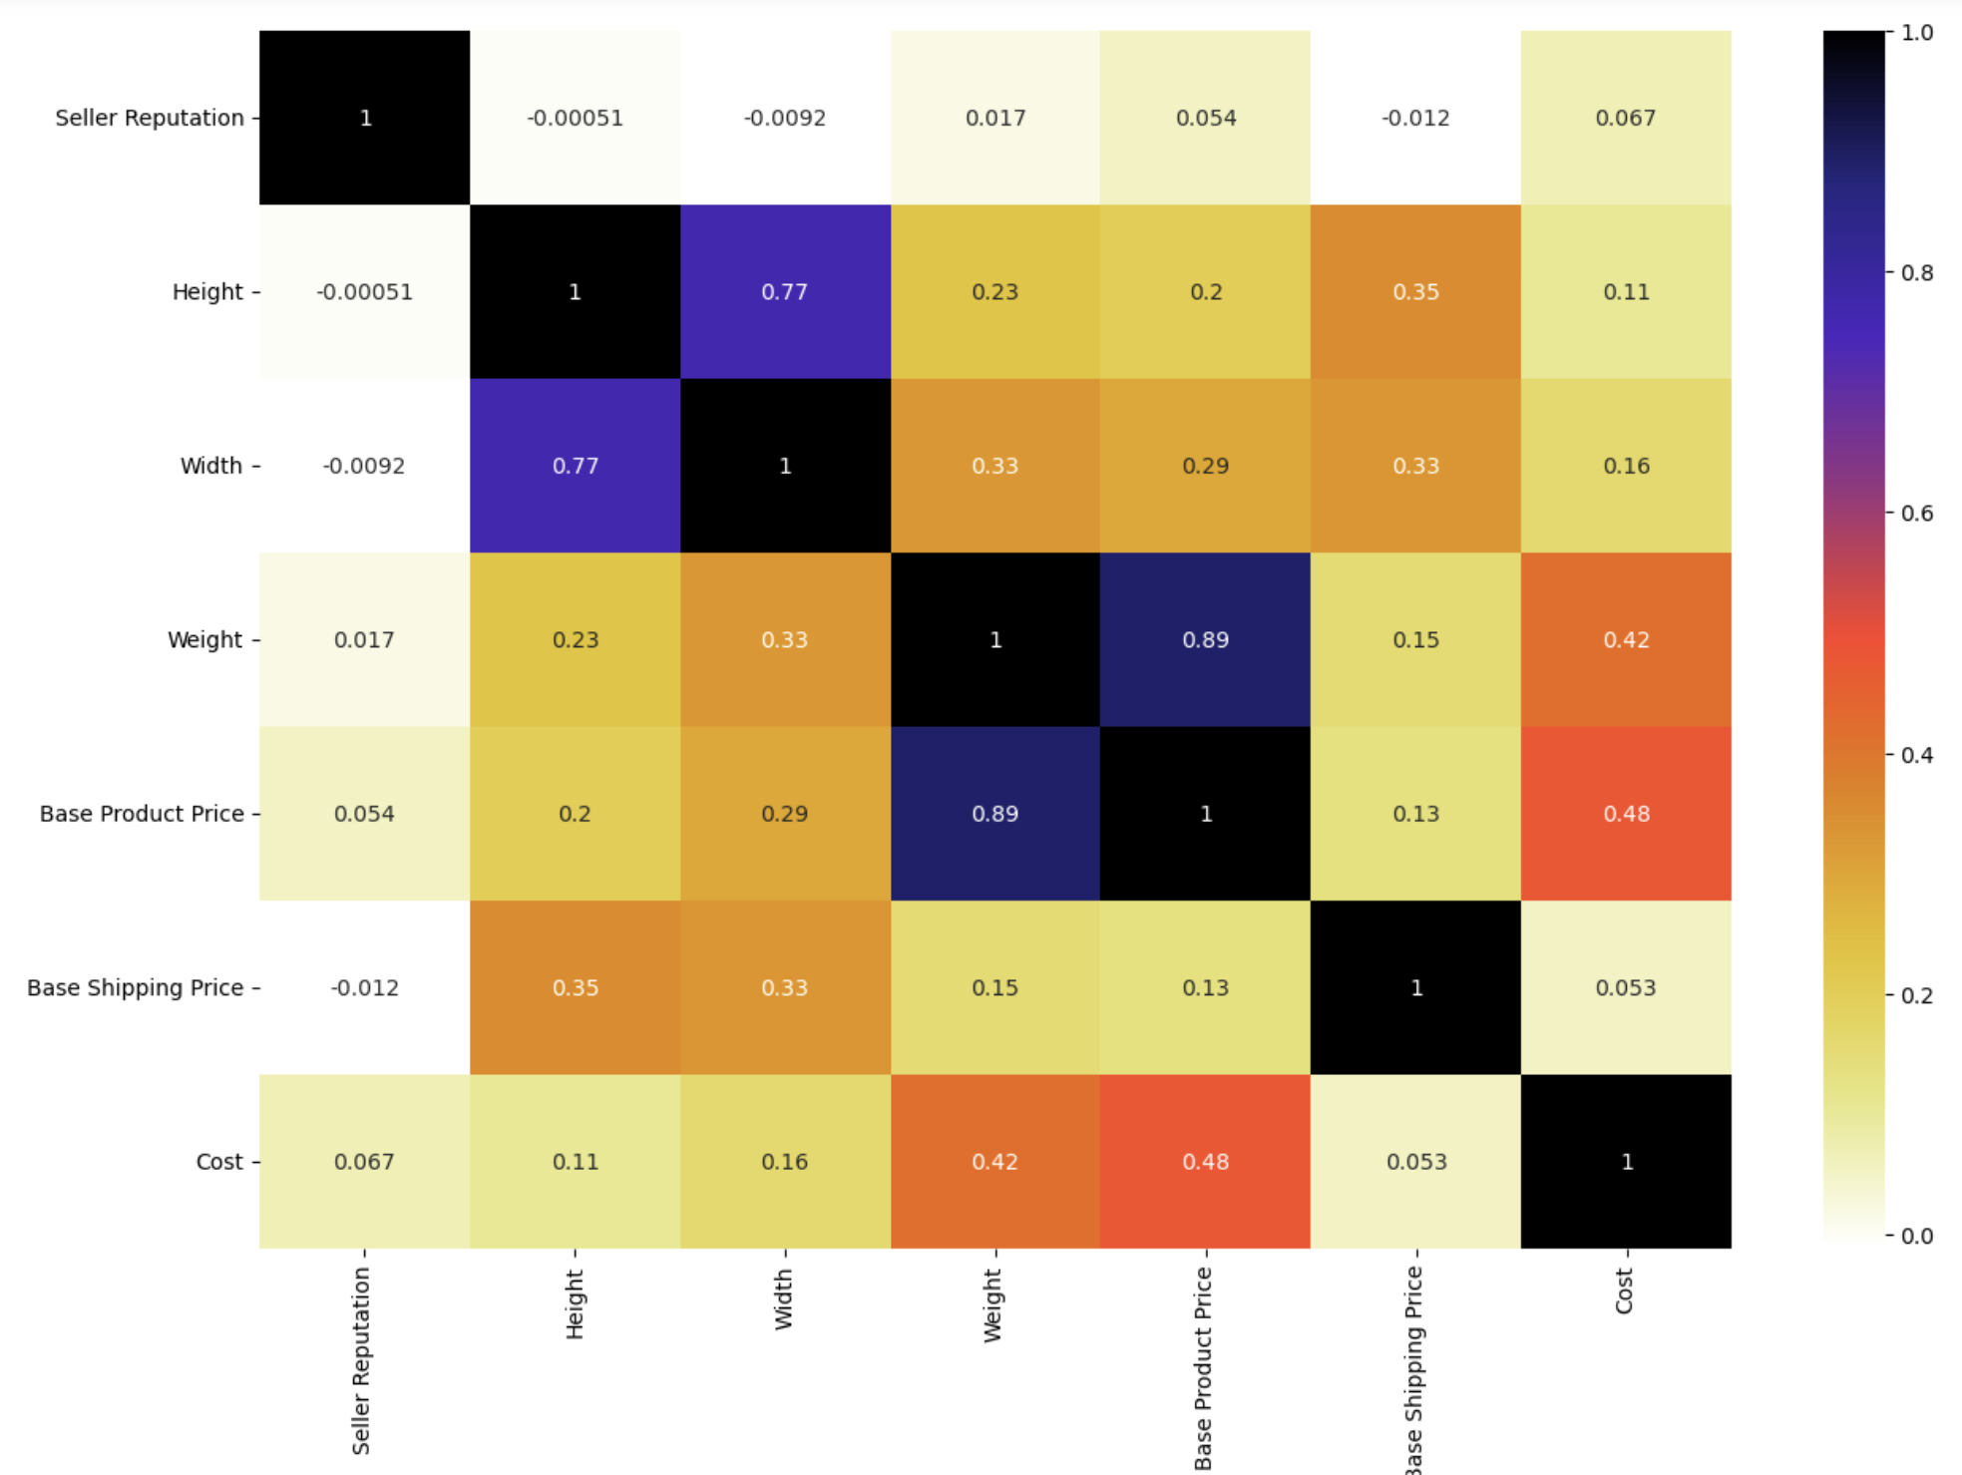
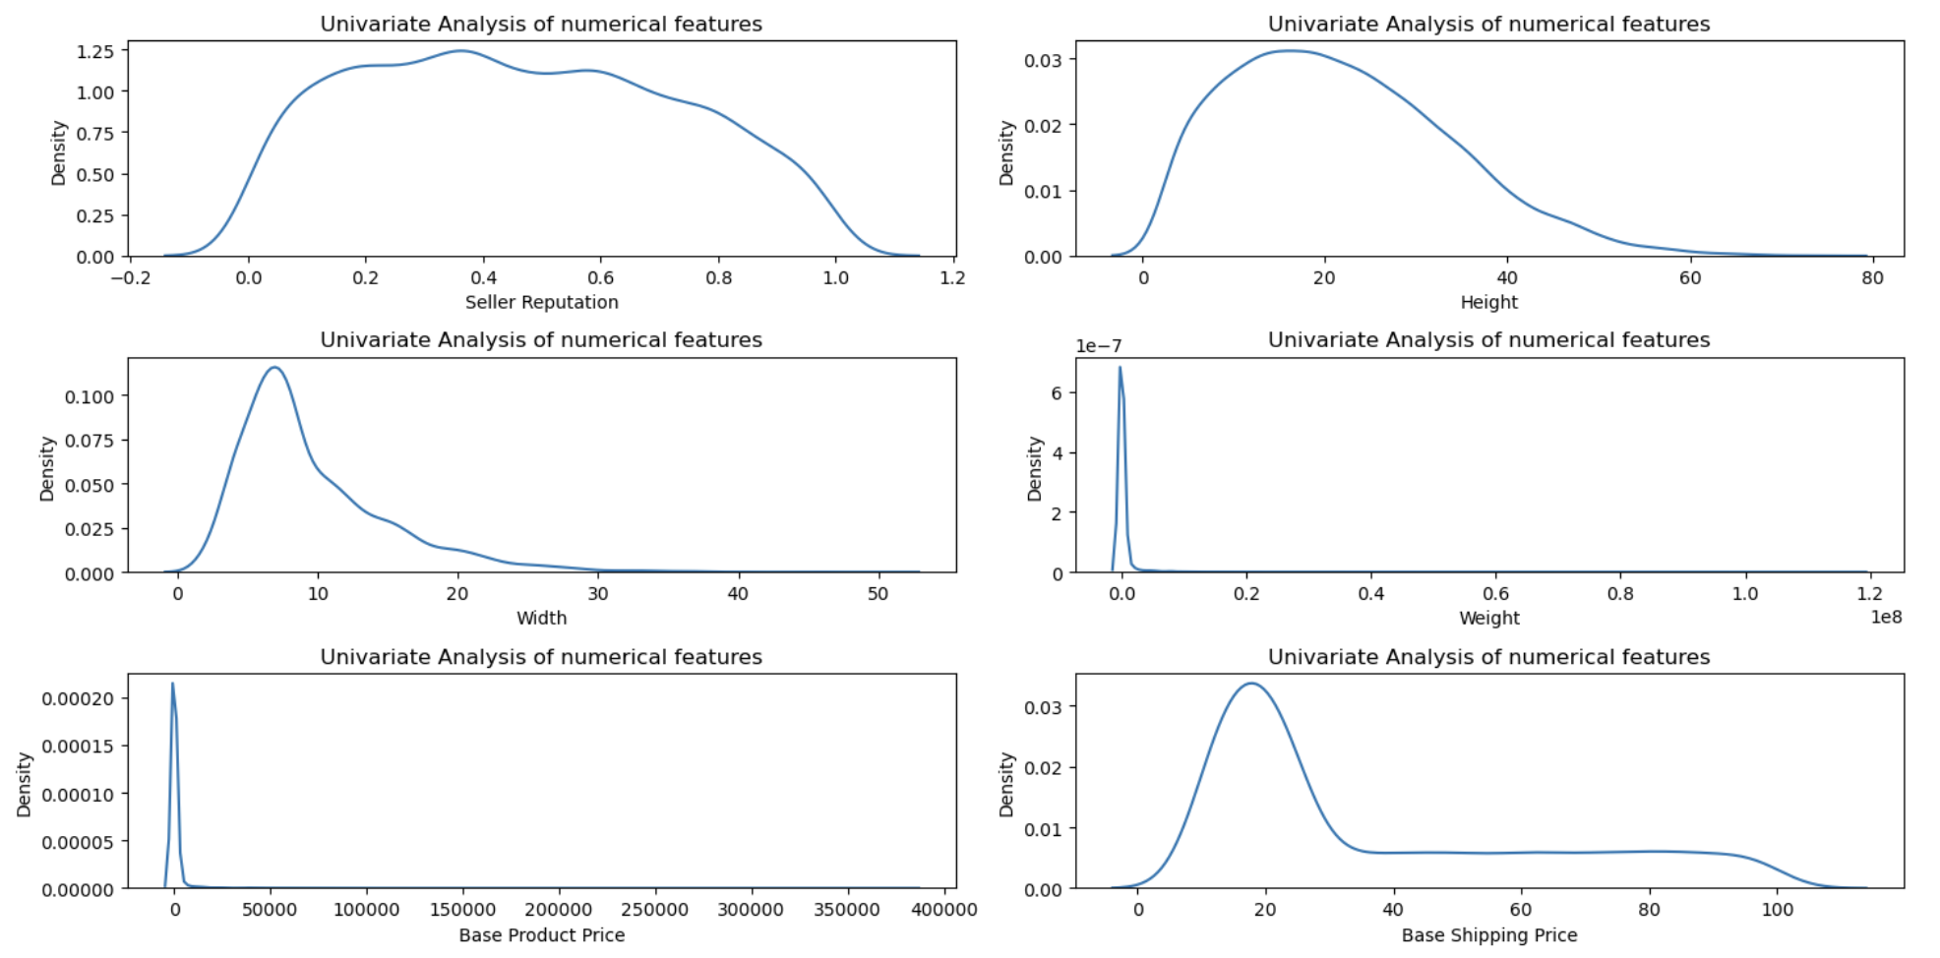
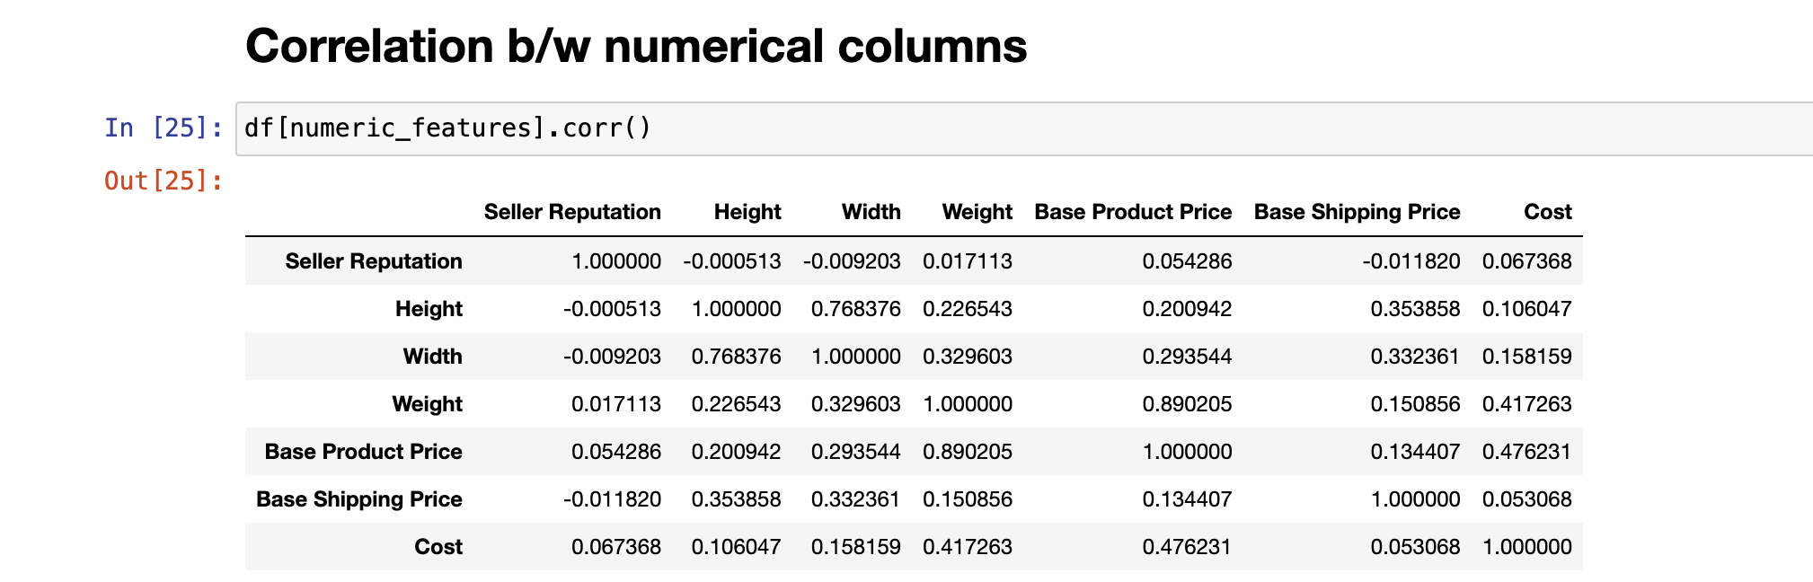
To find features, outliers, patterns and correlation we have done univariate analysis for better understanding and correlation of numerical columns with each other
This helps us identify variables that share high-correlation so it can be adjusted in the models and not cause bias

Slide 7
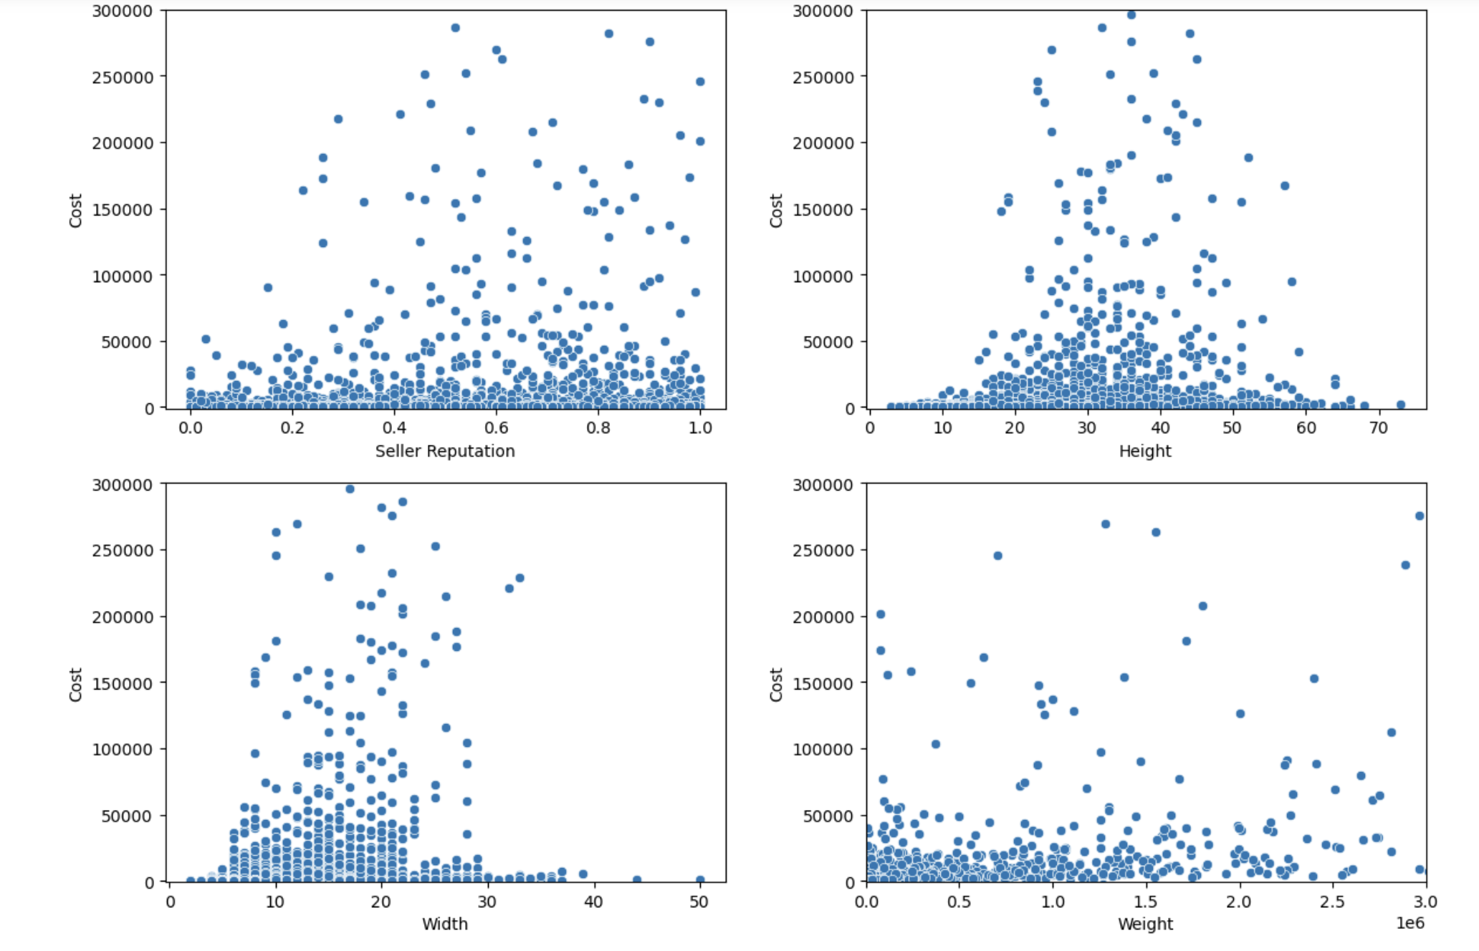
Scatter plot to find relation between cost and few variables

Slide 8
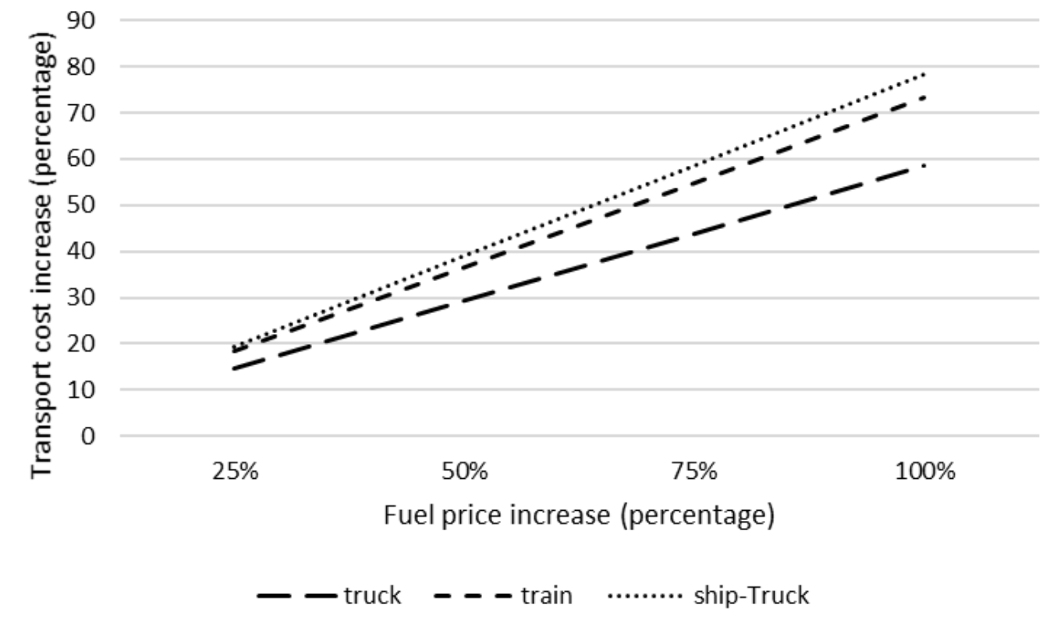
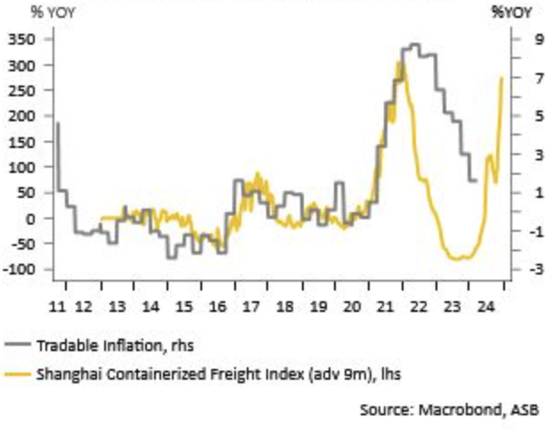
The Base Shipping Price is evaluated using reference shipping price and external factors which might affect the shipping price.
Factors such as seasonality, fuel pricing variations, inflation etc. will impact the value which is then fed into the prediction model
The figure shows fuel and transport cost increase from a public dataset and publication.
The figure shows correlation between freight cost index and inflation.

Slide 9
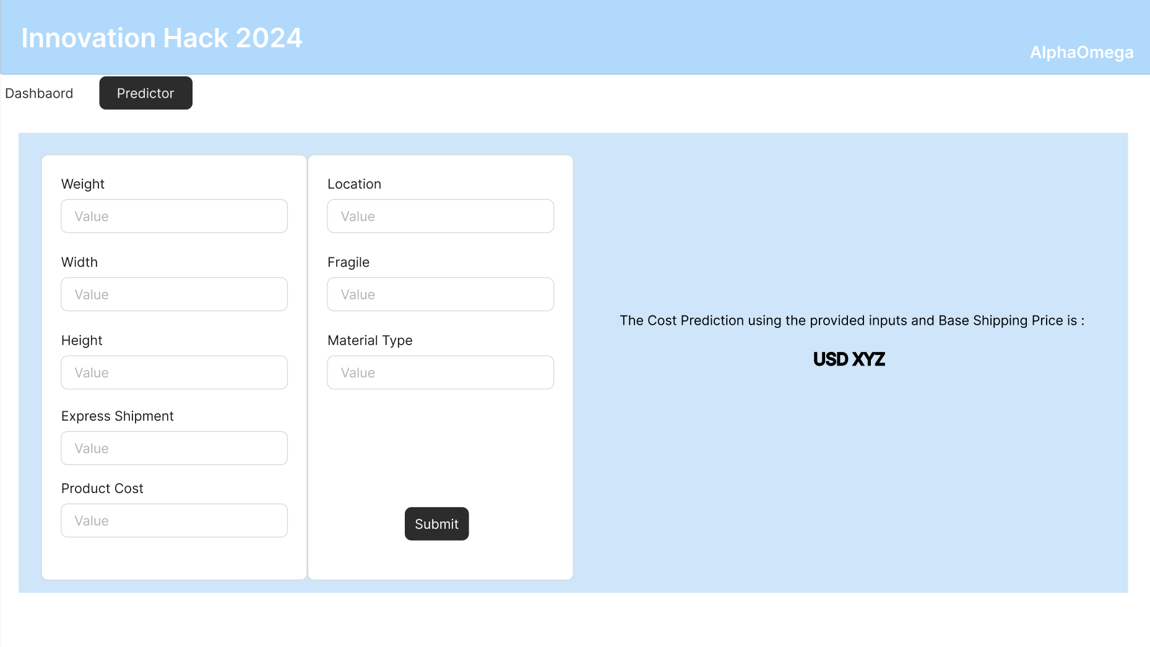
UI Mocks:

Slide 10
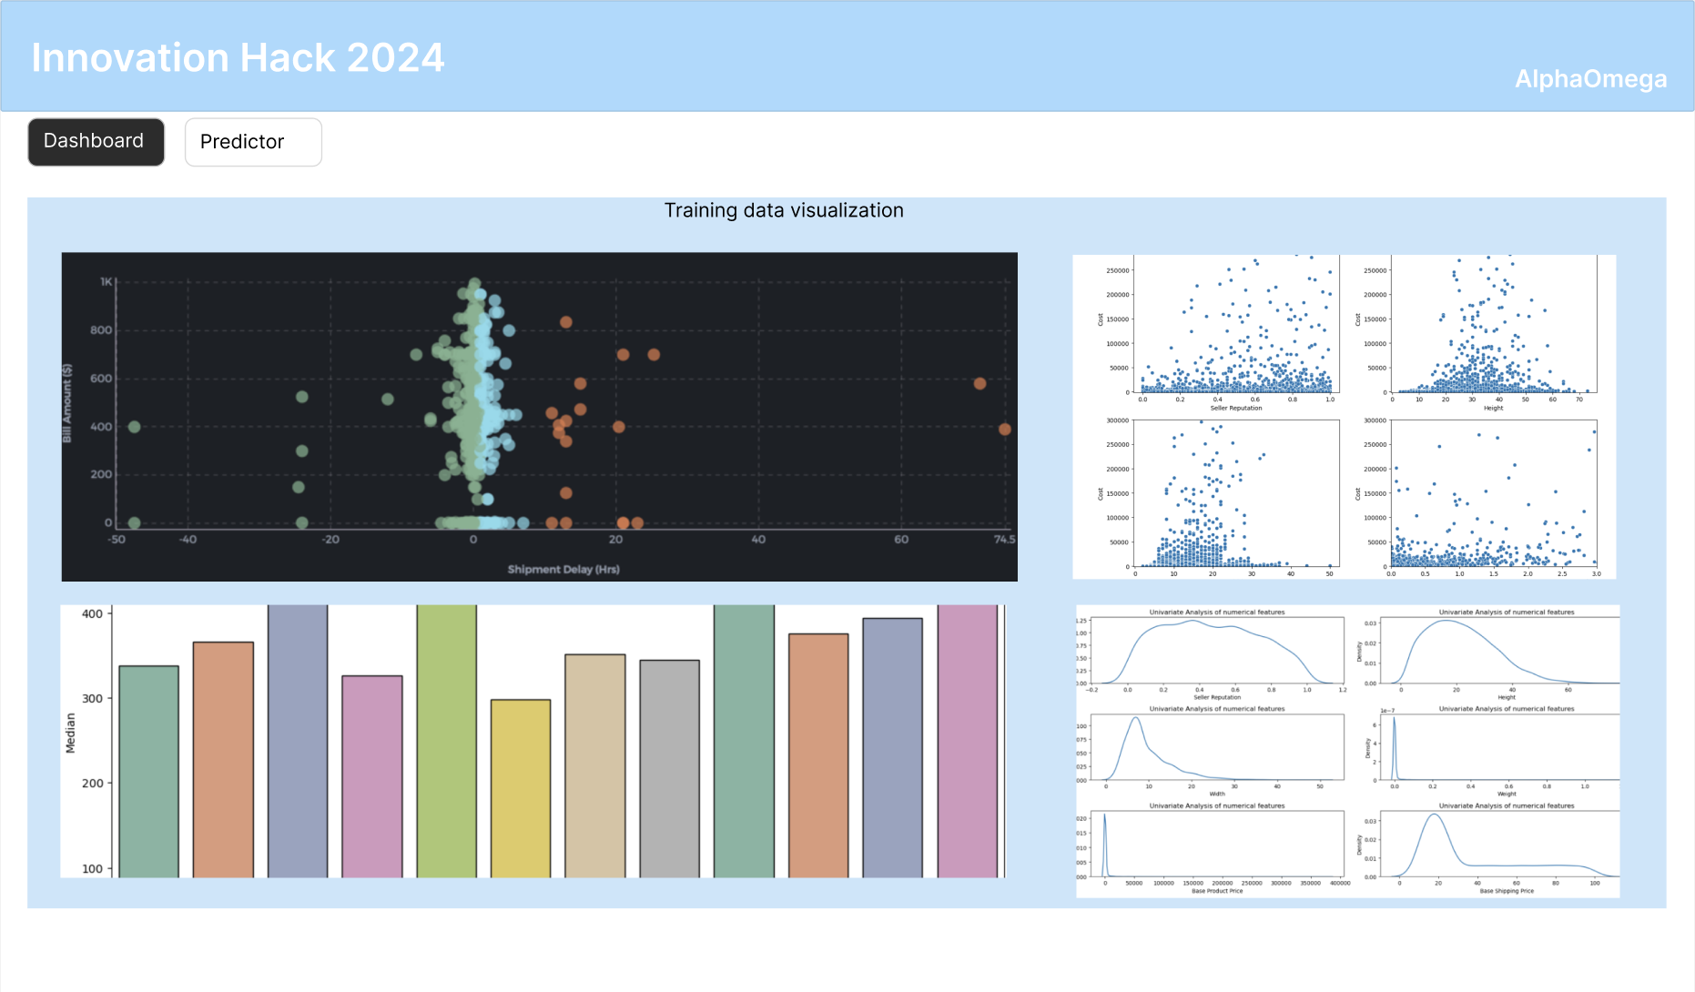

Slide 11
References:
https://www.researchgate.net/publication/326097263_The_effect_of_fuel_price_increase_on_transport_cost_of_container_transport_vehicles
https://www.researchgate.net/publication/366972748_Prediction_of_Shipping_Cost_on_Freight_Brokerage_Platform_Using_Machine_Learning#pf4
https://www.asb.co.nz/content/dam/asb/documents/reports/economic-note/shippingcosts-jun-2024.pdf
https://www.researchgate.net/publication/340241957_Machine_Learning-Based_Regression_Models_for_Price_Prediction_in_the_Australian_Container_Shipping_Industry_Case_Study_of_Asia-Oceania_Trade_Lane
https://www.sciencedirect.com/science/article/abs/pii/S0952197623008825

Slide 12
Thank You

